Slide 1

Customer Shopping Behavior Analysis
Uncovering key insights from transactional data to guide strategic business decisions.

Slide 2

Project Overview & Goals
Data Source
Key Focus Areas
Objective
3,900 purchases across various product categories.
Spending patterns, customer segments, product preferences, and subscription behavior.
Uncover actionable insights for strategic business decisions.

Slide 3
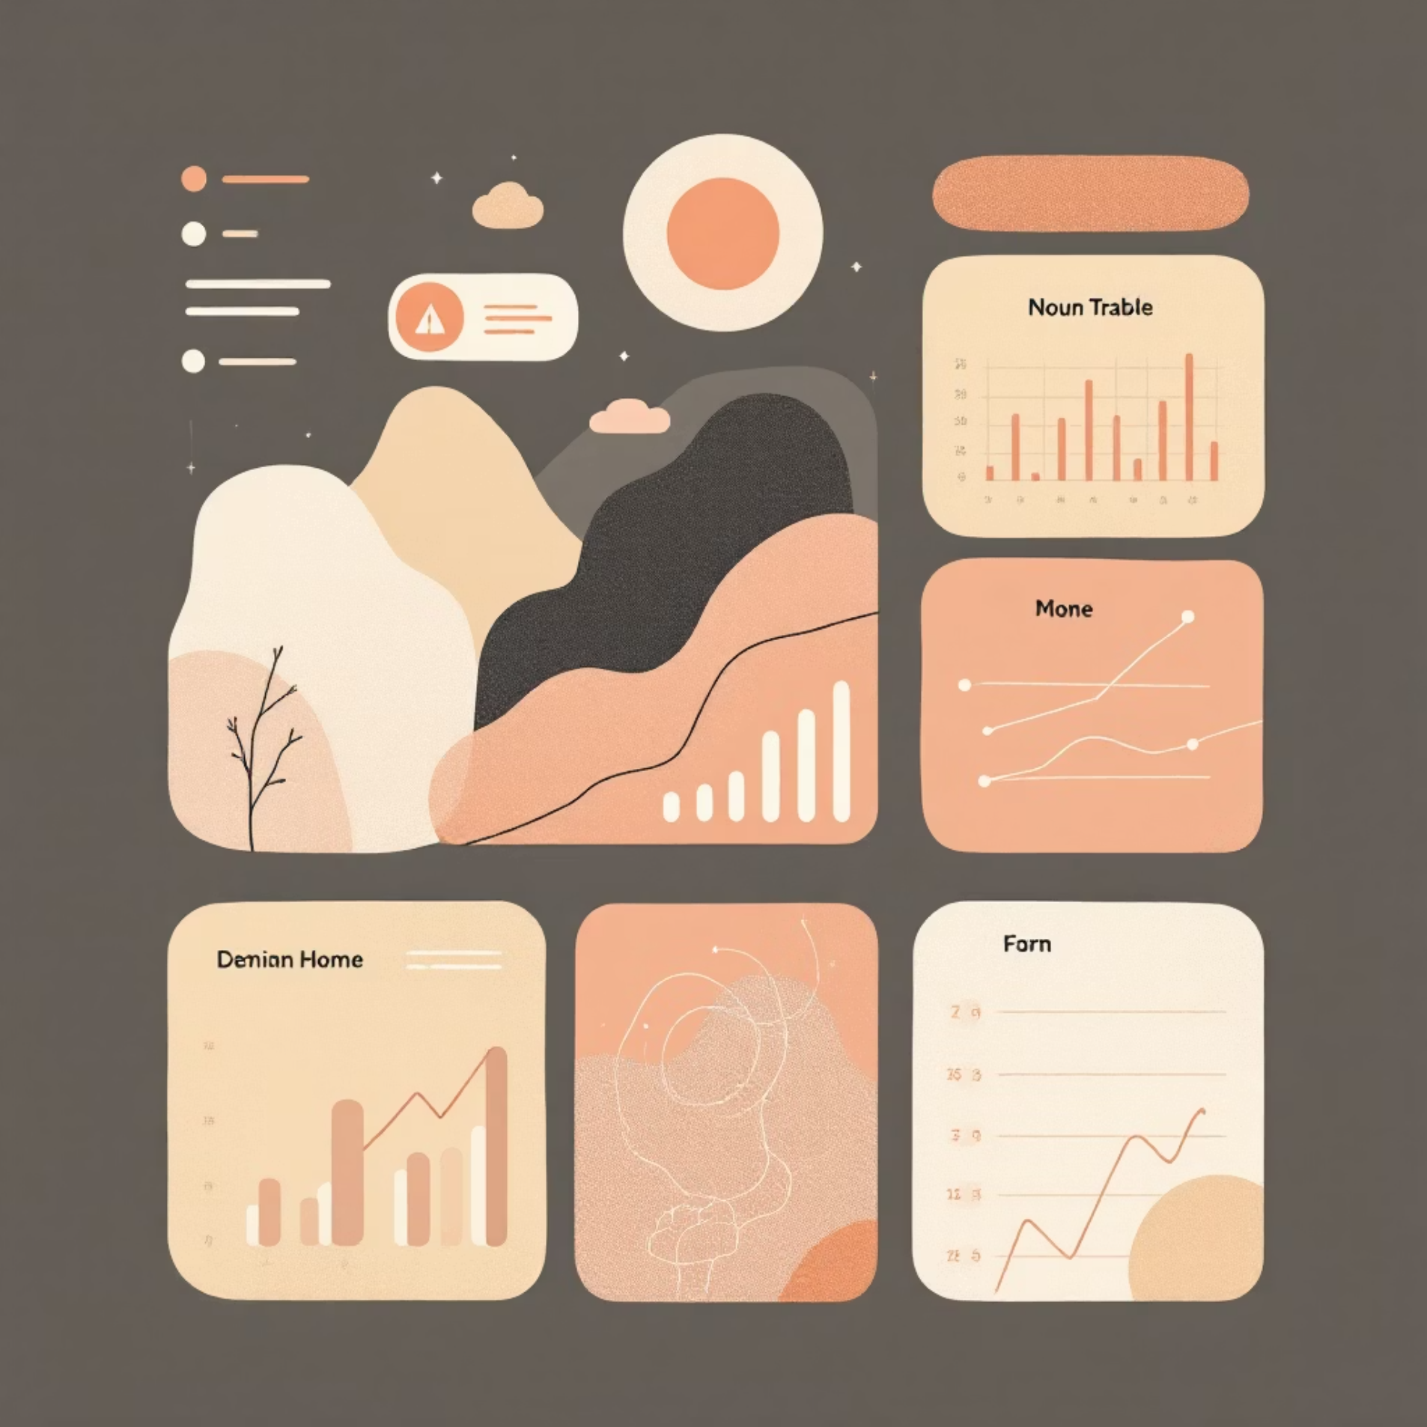
Dataset Summary
3,900
Missing Data Handled
Total Rows
37 Values
Purchases analyzed
Missing in Review Rating column.
Imputation
18
Filled using median rating per product category.
Total Columns
Key features
Key features include demographics, purchase details (Category, Amount, Size, Color), and shopping behavior (Discount, Shipping, Frequency, Rating).

Slide 4
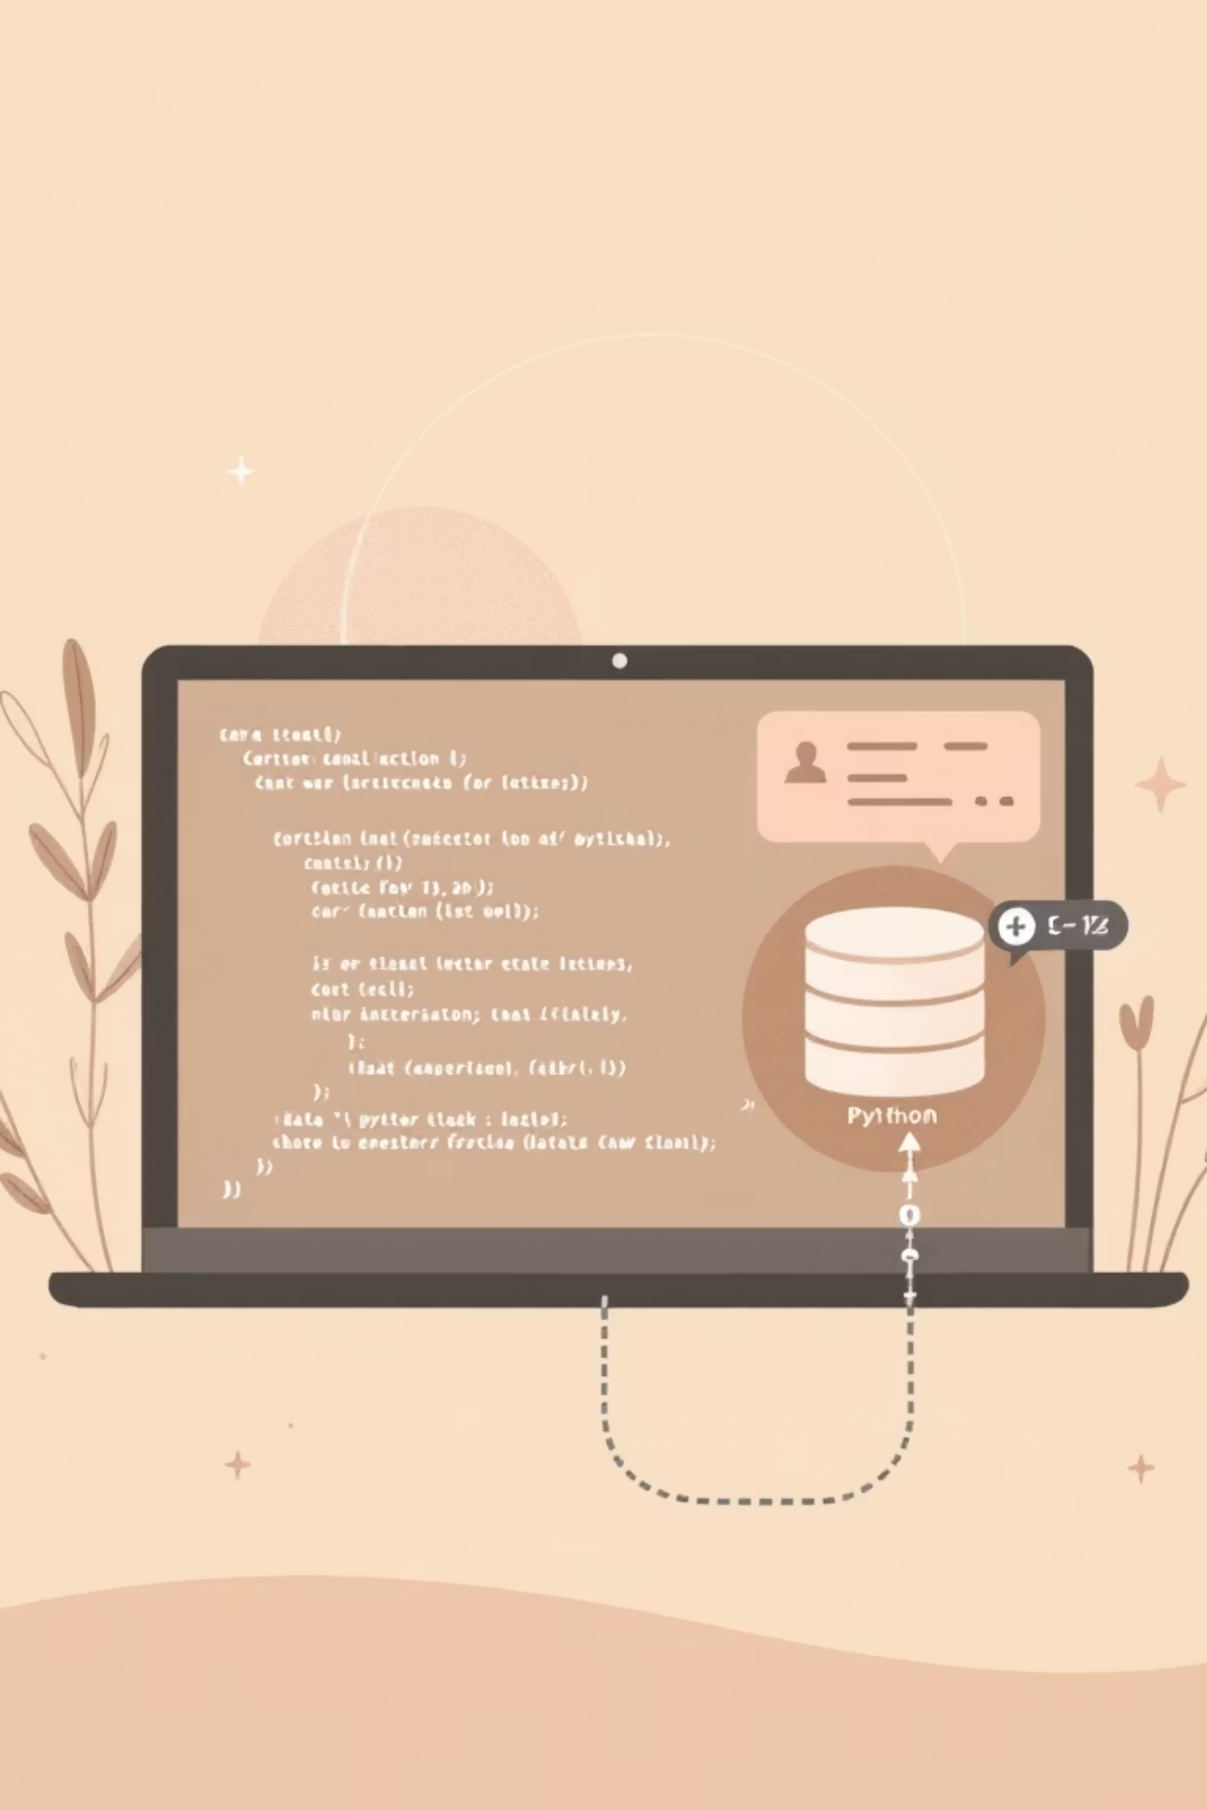
Exploratory Data Analysis (Python)
01
Data Preparation
Loading, initial exploration, and missing data handling.
02
Standardization
Renamed columns to snake_case for readability.
03
Feature Engineering
Created age_group and purchase_frequency_days.
04
Integration
Cleaned data loaded into PostgreSQL for SQL analysis.

Slide 5
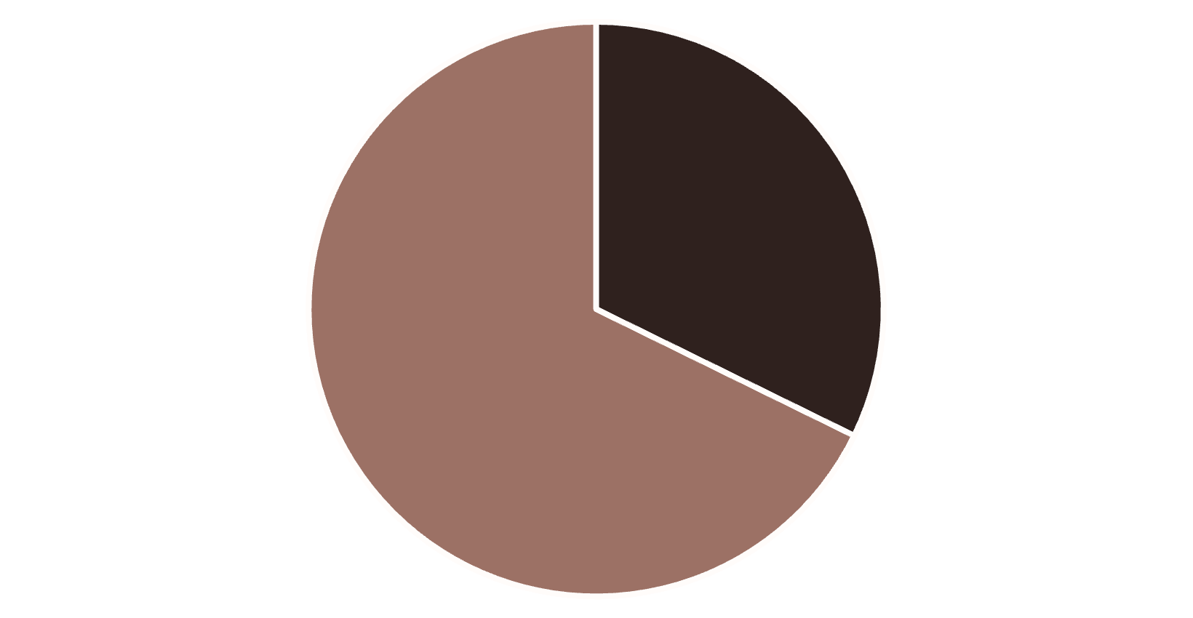
SQL Analysis: Revenue & Spending
Revenue by Gender
High-Spending Discount Users
839 customers used discounts but still spent above the average purchase amount ($59.76).
Shipping Type Comparison
Shipping Type
Avg. Spend
Standard
$58.46
Express
$60.48
Female
Male
Express shipping users have a slightly higher average purchase amount.

Slide 6
Product Performance & Ratings
Top 5 Products by Rating
Discount-Dependent Products
1
Gloves
Products with the highest percentage of discounted purchases:
3.86 Average Rating
50%
Hat
2
Sandals
3.84 Average Rating
49.66%
Sneakers
3
Boots
3.82 Average Rating
49.07%
Coat
4
Hat
3.80 Average Rating
48.17%
5
Sweater
Skirt
3.78 Average Rating
47.37%
Pants

Slide 7

Subscription & Loyalty Analysis
Subscribers vs. Non-Subscribers
Repeat Buyers & Subscriptions
Non-subscribers have a slightly higher average spend ($59.87 vs $59.49) but lower total revenue contribution.
Customers with >5 purchases are more likely to subscribe (958 Yes vs 2518 No).
Customer Segmentation
Loyal
Returning
New
3,116 Customers
701 Customers
83 Customers

Slide 8
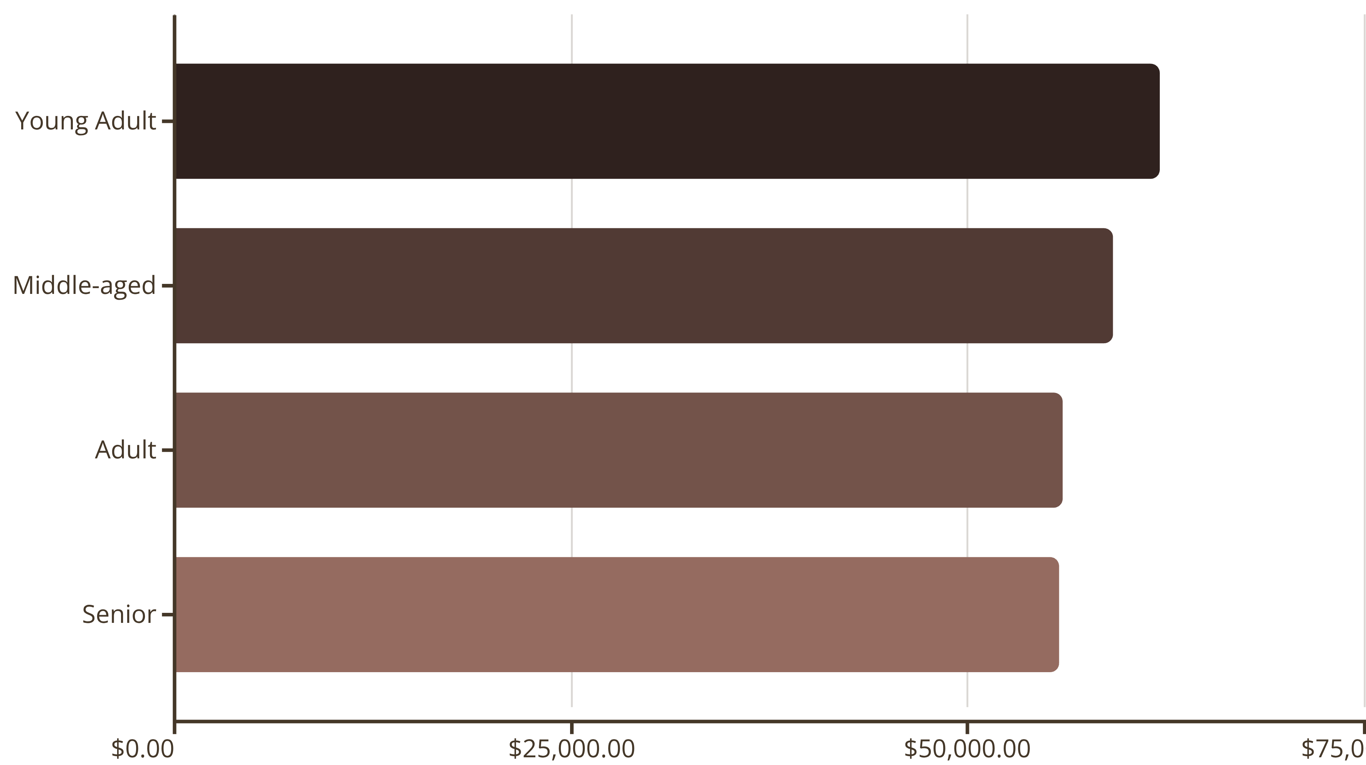
Revenue by Age Group
Understanding which age demographics contribute the most revenue.

Slide 9
Top Products Per Category
The most purchased items within the four main categories.
1
2
Accessories
Clothing
Jewelry (171 orders)
Blouse (171 orders)
Sunglasses (161 orders)
Pants (171 orders)
Belt (161 orders)
Shirt (169 orders)
3
4
Footwear
Outerwear
Sandals (160 orders)
Jacket (163 orders)
Shoes (150 orders)
Coat (161 orders)
Sneakers (145 orders)

Slide 10
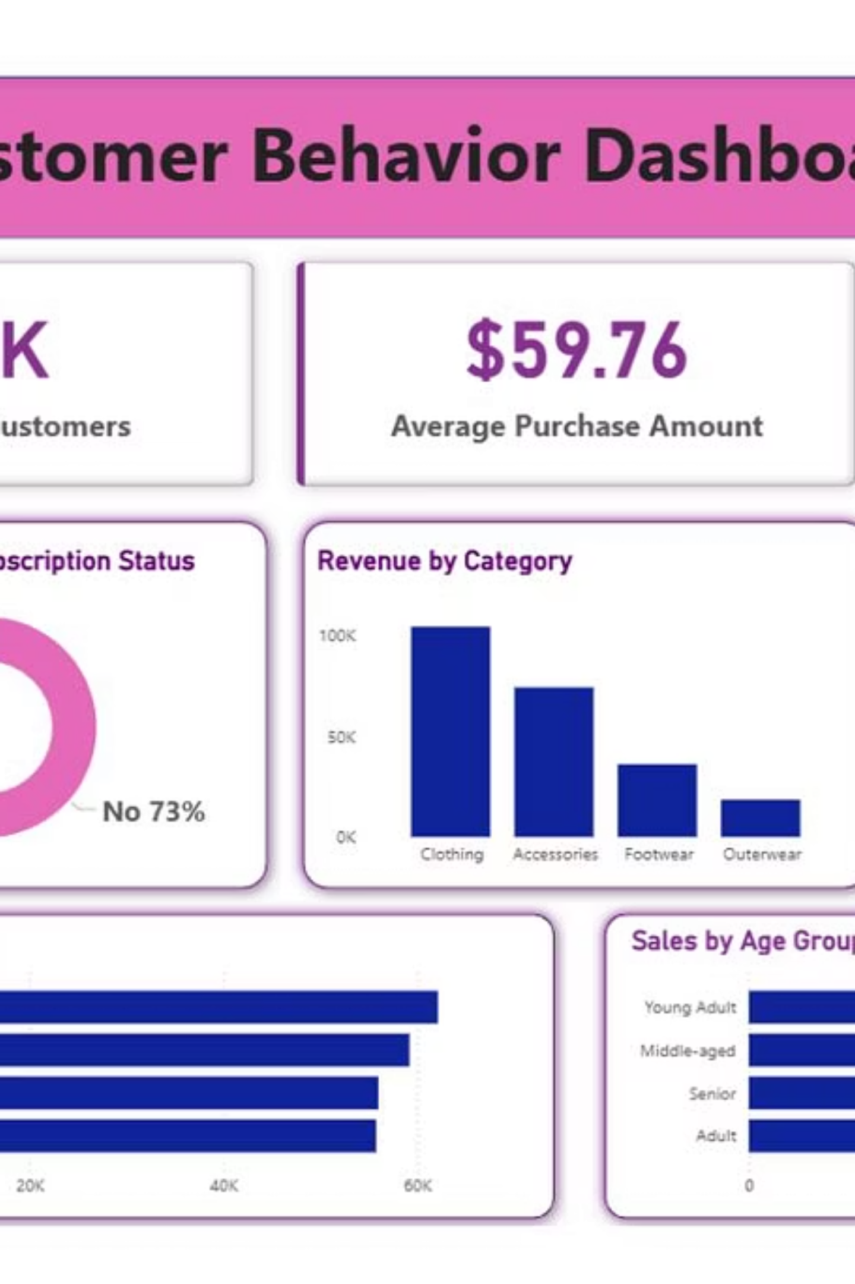
Key Business Recommendations
Boost Subscriptions
Promote exclusive benefits to increase subscriber base.
Customer Loyalty
Reward repeat buyers to grow the "Loyal" segment.
Targeted Marketing
Focus on high-revenue age groups and express-shipping users.
Product Positioning
Highlight top-rated and best-selling products in campaigns.

